Slide 1
Orientation Netherlands
WELCOME

Slide 2





YES placement partnership
YES au pair BV Netherlands
Belgium
Norway Denmark
BE international Canada
MEMBER OF:

Slide 3
Why YES placement?
YES placement is a professional & reliable training centre
YES placement offers training for Cultural Exchange programs like
Yes placement is affiliated with Yes au pair and is:
One of the largest au pair organizations in The Netherlands and Belgium
International Staff
Recognized by the Dutch government and IAPA and NAPO
5 years of experience
Vast support network
Provides a day tour in Kuala Lumpur City
Au pair
Internships
Work & travel
Study
Volunteer work

Slide 4
What is your idea about
CULTURAL EXCHANGE?

Slide 5

Goal & objective
Objective
Goal
To promote intercultural understanding
Exposing
Participating
Exchanging
Exploring
You will not be hired as a professional

Slide 6

What is an au pair?
Is part of the host family
Assists with both childcare and household duties
Gets allowance, free meals and lodging in exchange
Will learn the language
Gets to know the new culture
Makes international friends
Can stay up to one year
Will travel to new destinations
Will experience many new and exciting things
Will experience personal growth
Enhances her resume and future job opportunities
The term AU PAIR comes from the French language and literally means “on equal foot”.

Slide 7
What are the benefits?
€ 340 allowance per month
Free round trip airfare (€ 1,300)
Free room & board (€ 500 per month)
Free visa (€ 633)
Free insurance (€ 550)
Free language course (€ 275)
Free IYTC (travel discount card)
Usage of Pre-paid mobile phone
Free welcome pack
Contact numbers provided
Participation in many activities

Slide 8


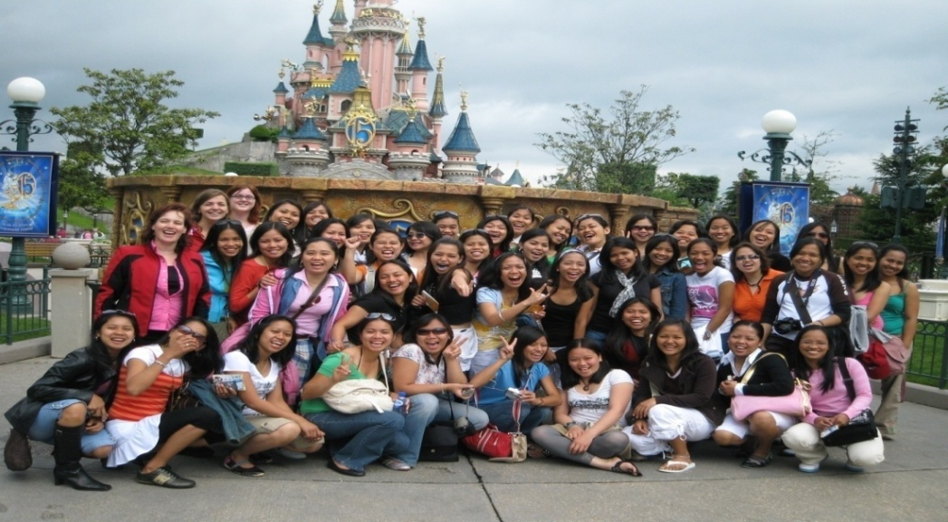

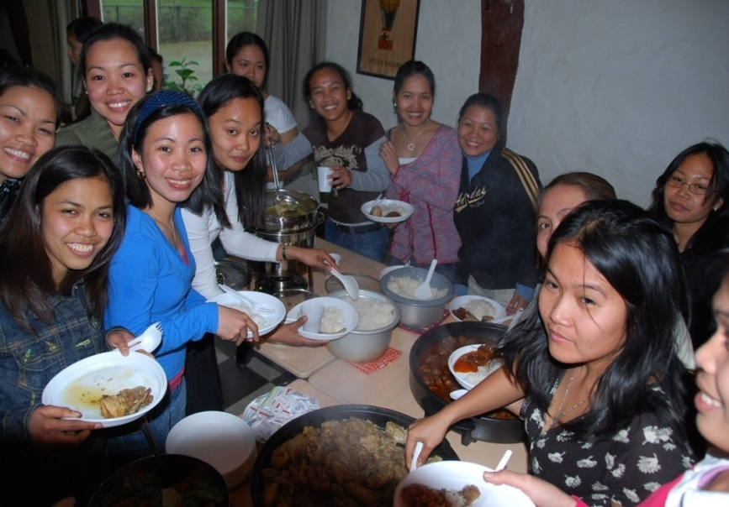
NAPO & YES au pair days

Slide 9
Training activities
2 weeks

Slide 10
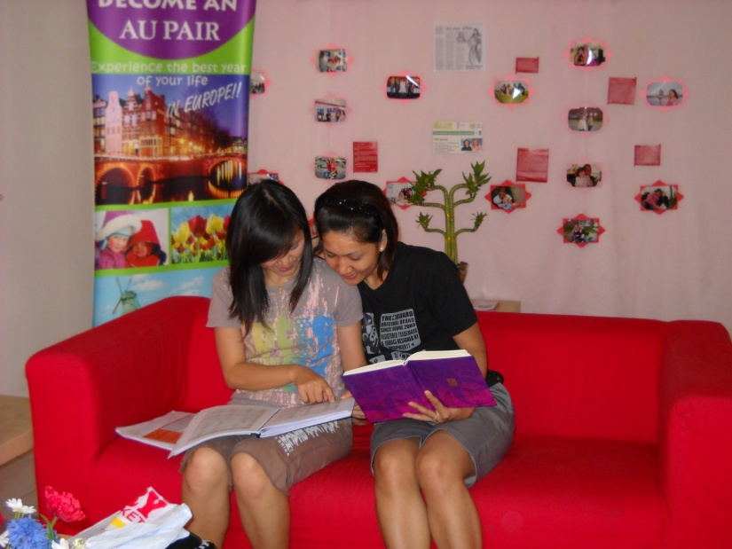
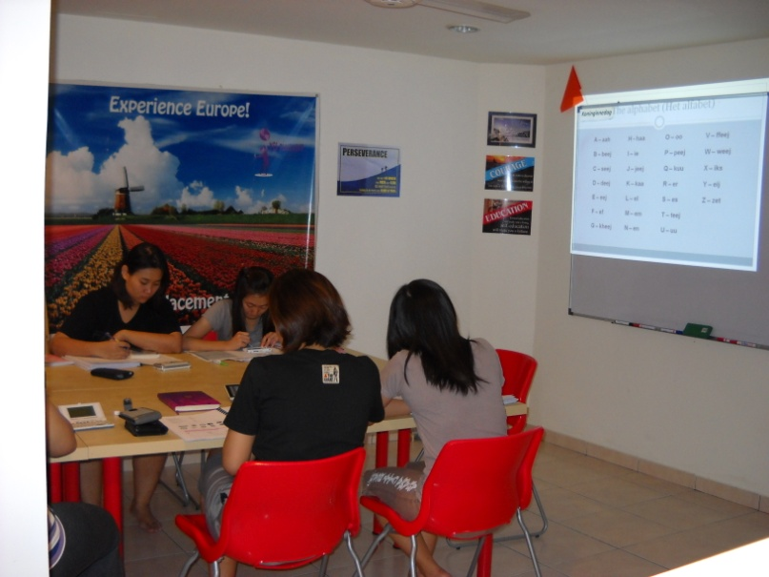
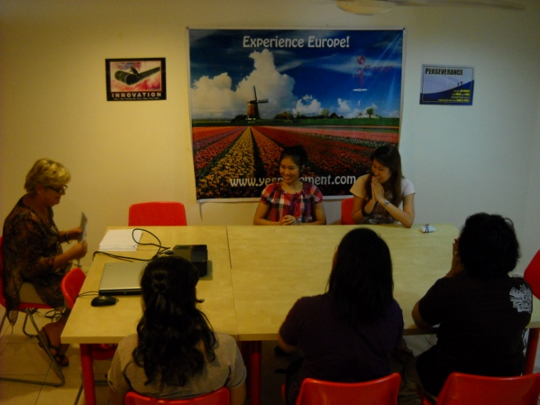
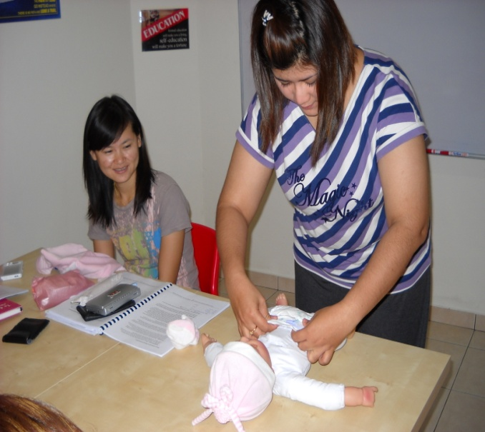
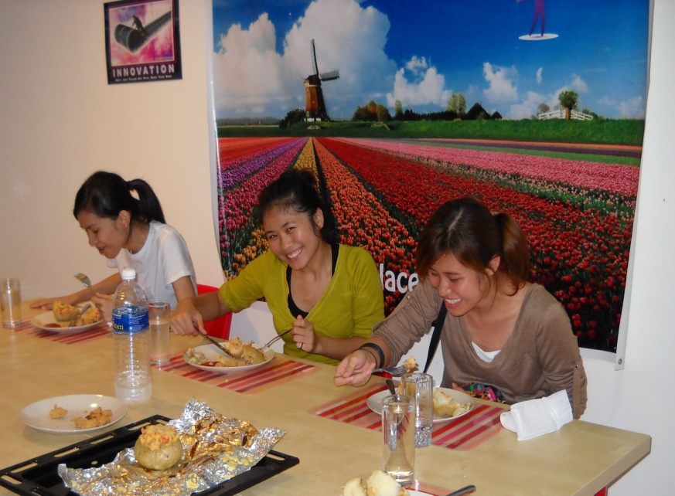
TWO WEEKS TRAINING IN CEBU PHILIPPINES

Slide 11
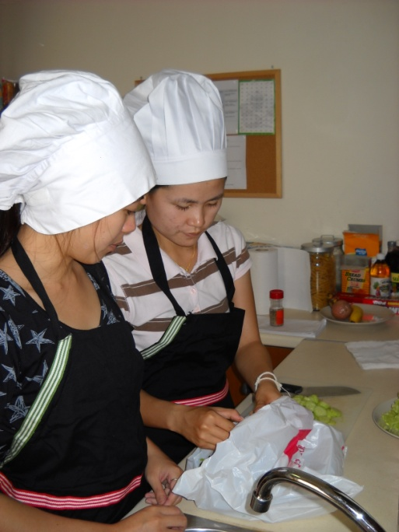
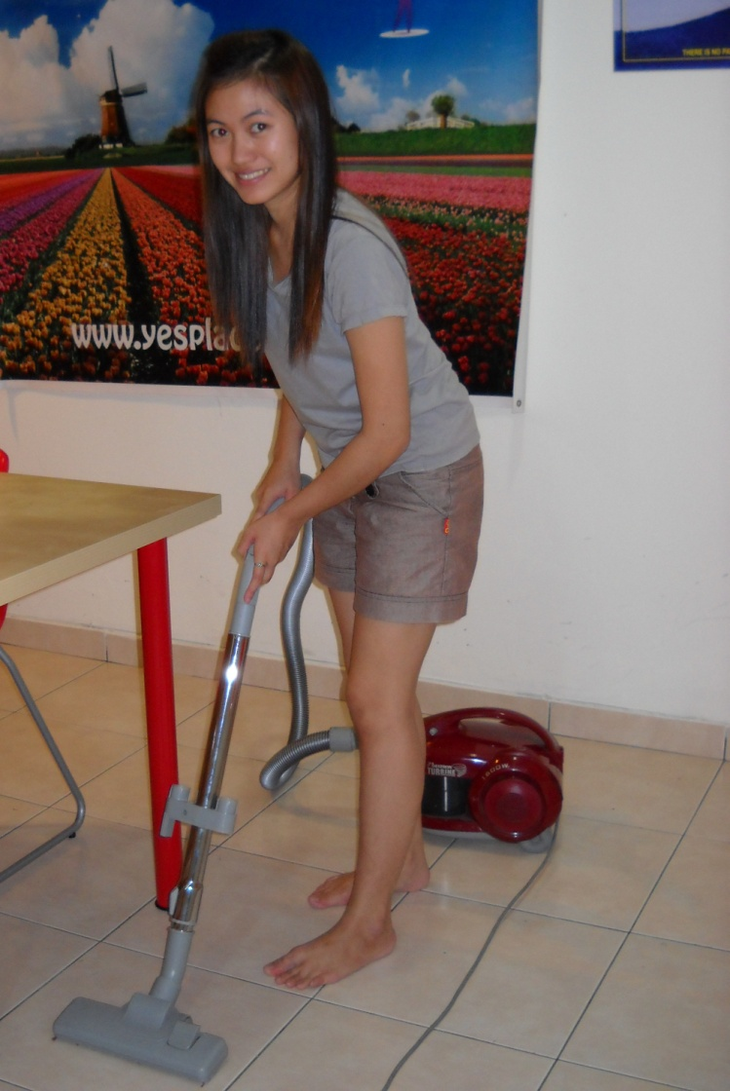
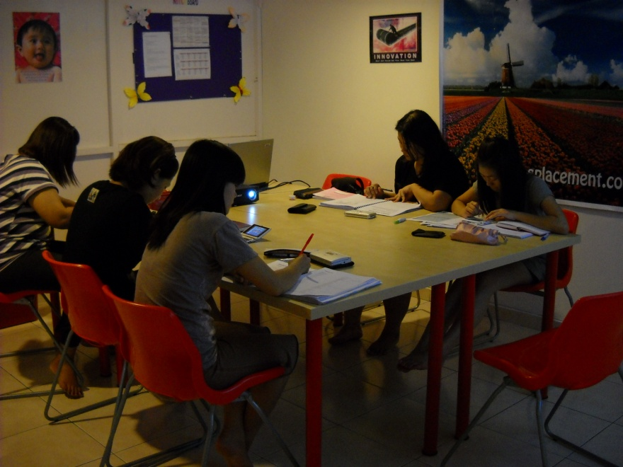
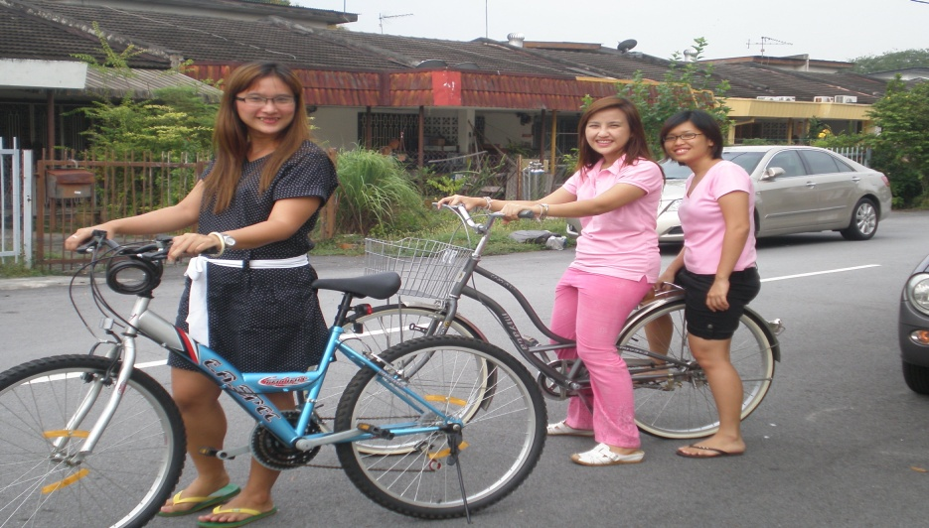
TWO WEEKS TRAINING IN CEBU PHILIPPINES

Slide 12
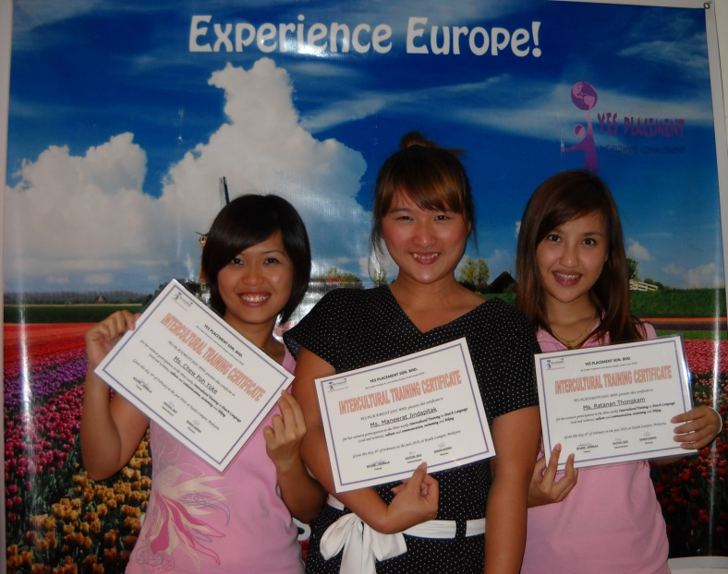
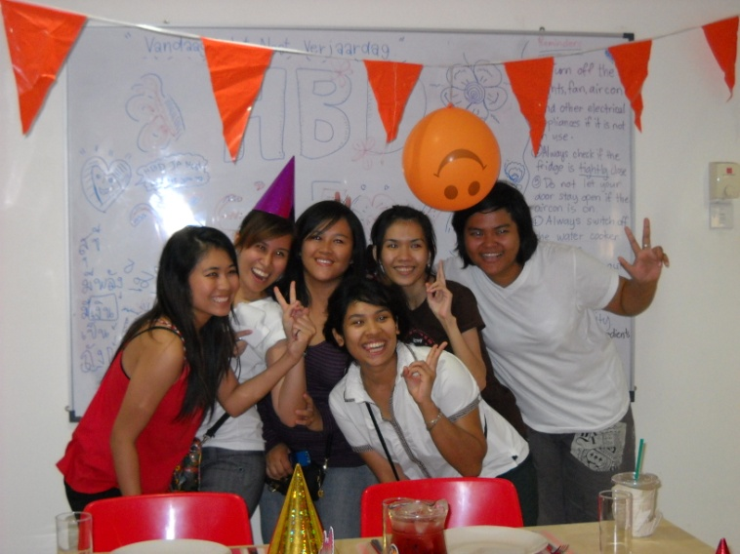
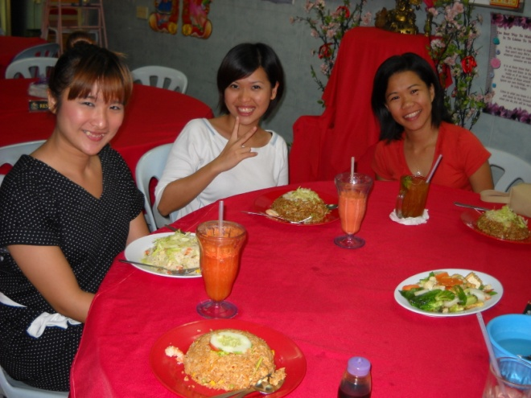
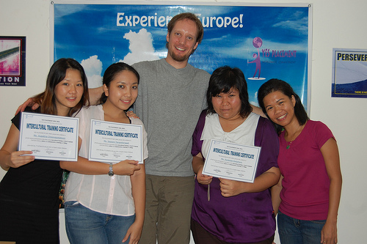
Awarding of Certificates

Slide 13
What are the requirements?
Personal requirements
Documentation requirements
Female
18 to 25 years old
Childcare experience
Single
No children
A graduate of secondary school or higher
Proficiency in English
Motivation to stay in a different culture, away from home and friends
Passport size picture
National passport
Birth certificate (English & original)
Certificate of no marriage (English & original)
Legalization of birth certificate at the Dutch embassy
Police clearance
Medical report
3 references (2 childcare, 1 character)
Educational diploma & Transcript of records

Slide 14
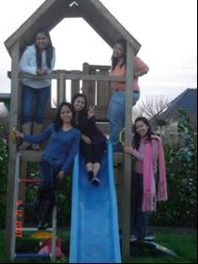
General application procedure
Fill out the YES au pair application form online on www.yesaupair.com
Orientation
  pre-screening
  Final screening
Training
Matching
Processing of Documents
Visa Application/Embassy Interview
Departure

Slide 15
Online registration
Application via Agency
www.yesaupair.com
Info for Filipina au pairs
Log in using YOUR
username & password
Register
Account
Personal Details
Preferences
Application
Application Form
Childcare Experience
General Info
Note: Fill in the forms completely and click SUBMIT!
If you have difficulty in accessing the website, search “proxy browser” in Google and click the “boom proxy-free online proxy browser” or any then enter site URL www.yesaupair.com.
Images/Dear Family letter

Slide 16
Thank you very much for your attention!

